Slide 1
Analysis & Recommendations
Corporate carbon footprint data review:
key insights
Limitations
next steps
1

Slide 2
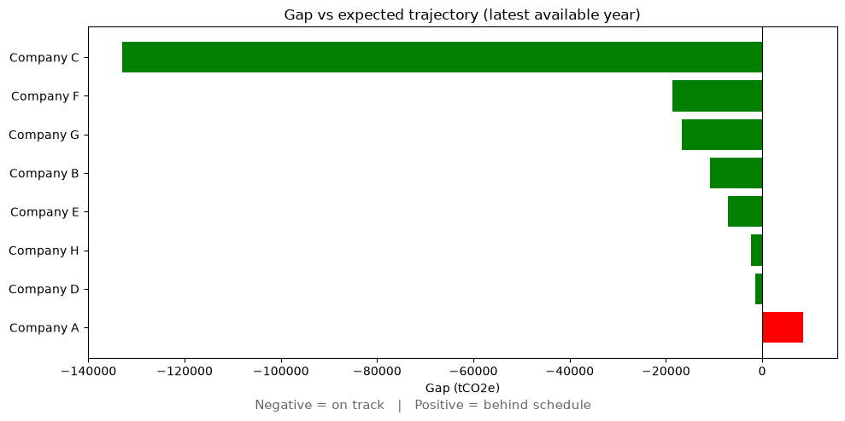
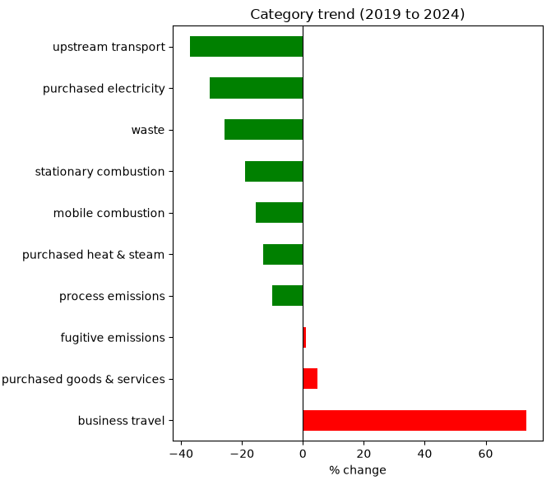
Key Insights
Company A is the only company at risk on its Scope 1+2 target
Gap of +8,536 tCO2e in 2024 → persistent since 2021 and widening.
A structural issue, not a one-off, despite an SBTi-validated target.
Business travel is the fastest-growing emission driver
+73.2% (2019–2024), fully offsetting the best reduction in the data (upstream transport, -37.1%).
Scope 3 is excluded from every target, yet represents ~74% of emissions
Companies track on Scope 1+2 while total footprints grow (Company B +12.9%, Company A +15.8%) → a credibility blind spot.
2

Slide 3
Limitations
Data quality issues affect analytical reliability
8 duplicates, 8 nulls, 1 invalid year (2099), 1 invalid scope (4), 3 negatives, 2 naming inconsistencies ➔ all handled in staging.
Scope 3 reporting is incomplete and inconsistent
Companies do not report all categories every year (e.g. Company A starts Purchased goods & services in 2021)
Year over year comparisons can be unreliable.
Target progress is measured on Scope 1+2 only
A company can be on track yet growing its total footprint.
Negative emissions could not be validated
It can materially shift trends: Company G reduction -51.6% → -28.9% after exclusion
3

Slide 4
Next Steps
Validate and integrate Scope 3 into target commitments
Quantify the gap between Scope 1+2 pledges and full-footprint targets
Assess initiative delivery vs planned reductions
Cross-reference completed initiatives' estimated_reduction against observed emission changes. Especially for Company A, where planned effort may not close the gap.
Investigate business travel growth drivers
Company-level breakdown: structural growth or post-COVID rebound ?
Travel policy and remote-work practices.
Resolve data quality issues with source teams
Reconcile negatives, naming, and incomplete Scope 3 with reporting teams; Standardise guidelines to improve reliability for future cycles.
4

